Slide 1

The Importance of Nature and the Seasons in Religion and Worldviews
I wonder why nature and the seasons are significant for religion and worldviews?
My learning road map:
What I will know and understand
How I will show that I know it
Topic
Lesson 1. Why might
nature and the seasons be
important in religion and
worldviews?
Lesson 2. Are nature and the seasons important for those with
non-religious worldviews?
1. I know ways that nature and the seasons may be important in religion and worldviews.
2. I know that routine and repetition are often important to worldviews and can be observed (e.g. the cycle of festivals, the routine of ritual).
I know that pattern and place are often central to worldviews and can be studied via observation.
What should I already know?
Children should have started to develop an individual’s knowledge and understanding of different religions, beliefs and worldviews which form part of society.
They should be beginning to know about different values and worldviews.
Children should have experience on how to reflect on what they say and how they behave.
National Curriculum:
To continue to develop an individual’s knowledge and understanding of the religions and beliefs which form part of
contemporary society.
To continue to inform on children's values and to encourage them to reflect on what they say and how they behave.
To continue to provoke challenging questions about the ultimate meaning and purpose of life,
Lesson 3. How have nature and the
seasons been central to Christian
worldviews?
3. I know that interviewing individuals is a good way to find
out about their worldviews and the beliefs, values and
practices central to them.
I know that place and time may influence the beliefs and
practices of those with religious and non-religious worldviews (e.g. Christians now and in the past and Christians in the future).
Lesson 4. How do nature and the seasons shape Jewish and Muslim
worldviews?
4. I know that interviewing individuals can reveal aspects
of a worldview otherwise unseen and demonstrate
how people’s lived experiences might differ from one
another, even if they identify as being from the same religion/worldview.

Slide 2
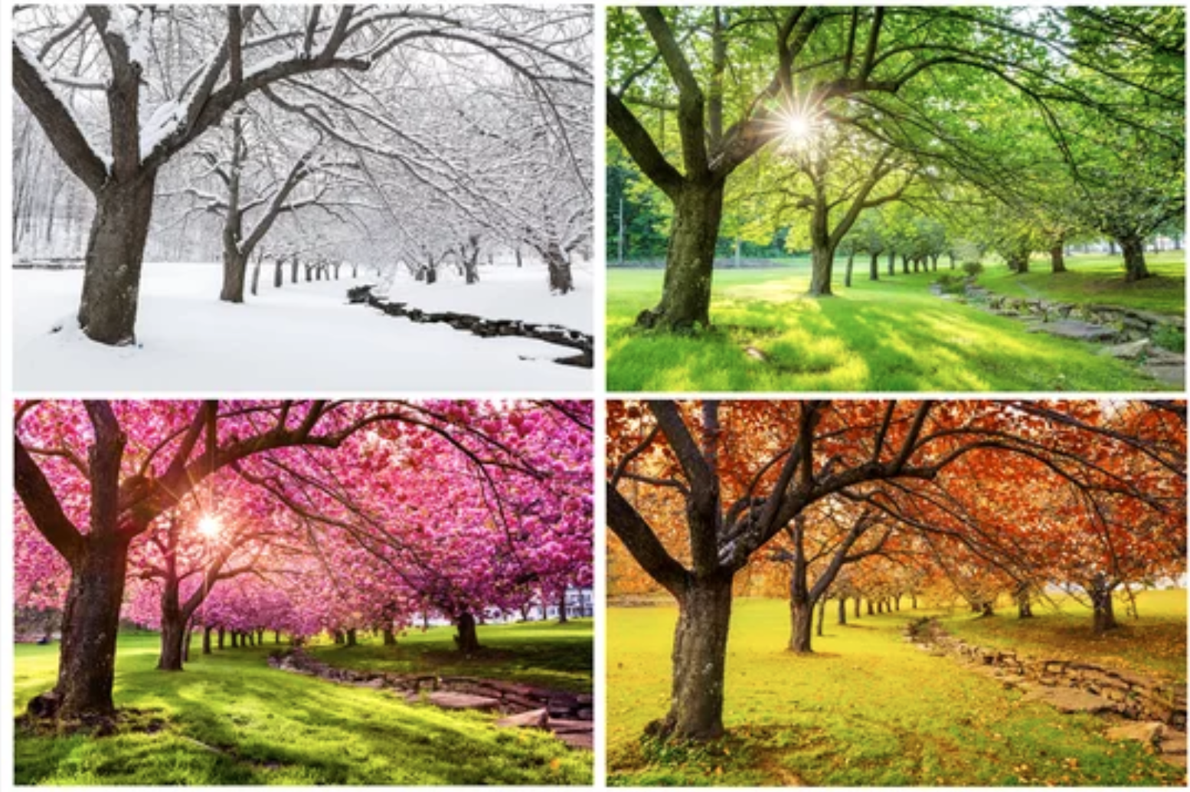
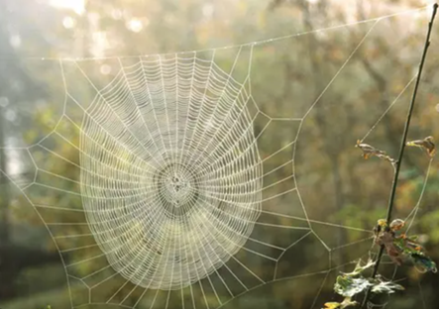
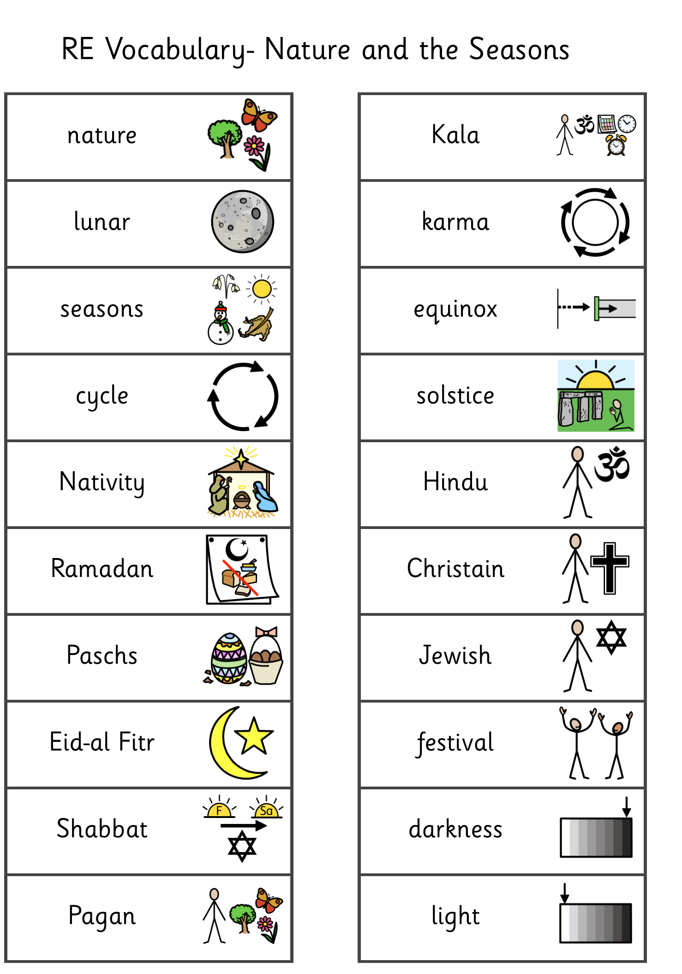
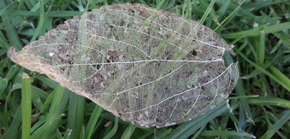
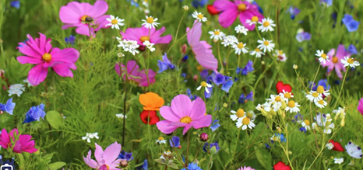
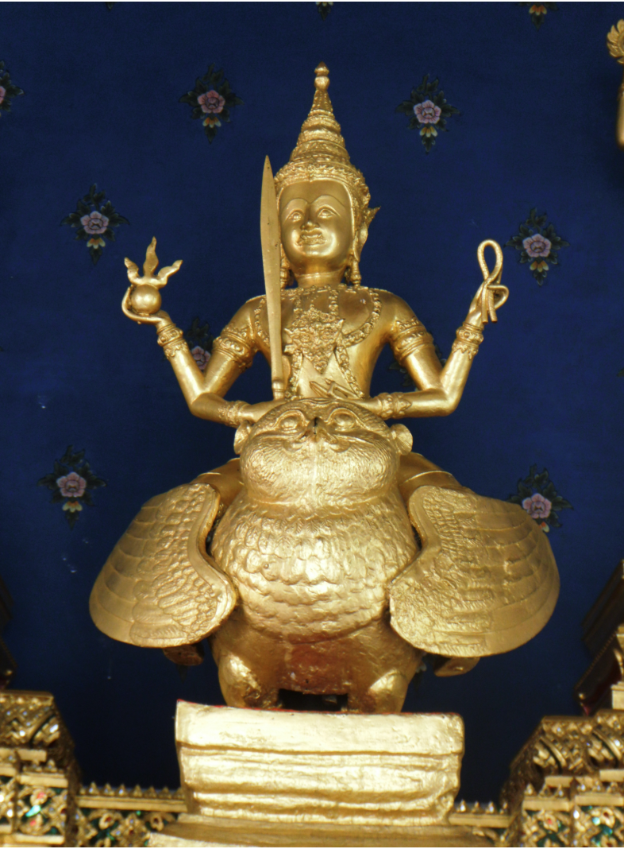
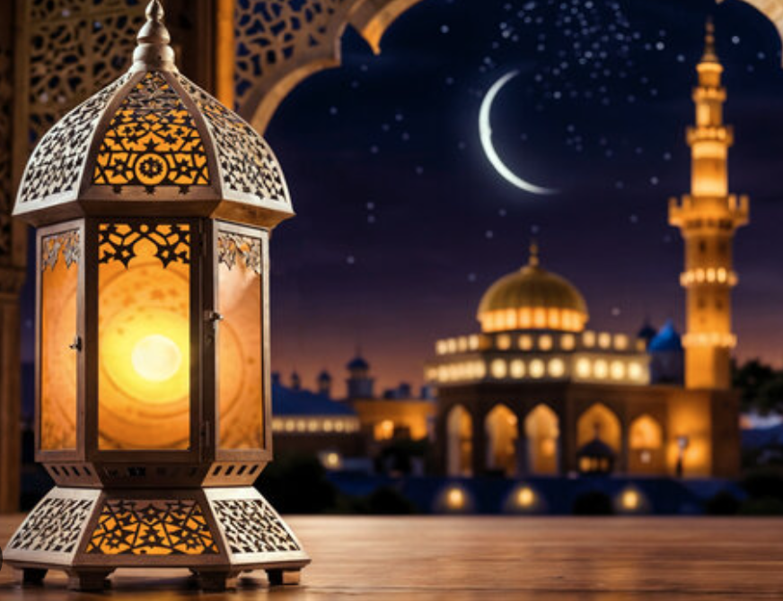
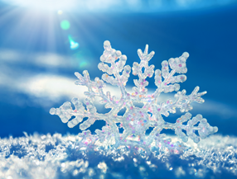
Vocabulary that I will learn and use during this unit of work:
Ramadan -Muslims
celebration observed with
fasting from dawn to sunset.
Kala – The
Hindu personification
of time.

