Slide 1

My learning road map:
What I will know and understand
How I will show that I know it
Worldviews, Art and Architecture
I wonder how religion and worldviews are shaped and
expressed through art and
architecture?
Topic
Lesson 1 Can religion and
worldviews be shared with other people
through art and architecture?.
What should I already know?
Children should have started to develop an individual’s knowledge and understanding of different religions, beliefs and worldviews which form part of society.
They should be beginning to know about different values and worldviews.
Children should have experience on how to reflect on what they say and how they behave.
1. I know now that the time and place of a religious artist will be evident in their art work.
I know that religious art can represent beliefs in pictorial form.
I know that religious artists can represent the same
religious beliefs but in diverse ways.
2. I know that religious art and architecture can hold theological and spiritual significance.
I know that the time and place of a religious building can influence the architecture.
National Curriculum:
To continue to develop an individual’s knowledge and understanding of the religions and beliefs which form part of
contemporary society.
To continue to inform on children's values and to encourage them to reflect on what they say and how they behave.
To continue to provoke challenging questions about the ultimate meaning and purpose of life,
Lesson 3 How are ideas about Allah represented in Islamic art & architecture?
Lesson 2 Can a building
represent a theological idea?
4. I know that theological and spiritual ideas can be experienced communicated
through dance.
I know that dance can offer individuals
a spiritual experience
3. I know that patterns and stylised writing can also be used to convey important theological ideas, as is the case in Islam.
Lesson 4 Can dance
represent religious ideas?
Lesson 5 How do sacred buildings invite movement of the body?
5. I know that religion can be embodied (experienced through the body).
I know that sacred places can encourage actions and reactions from people’s bodies

Slide 2
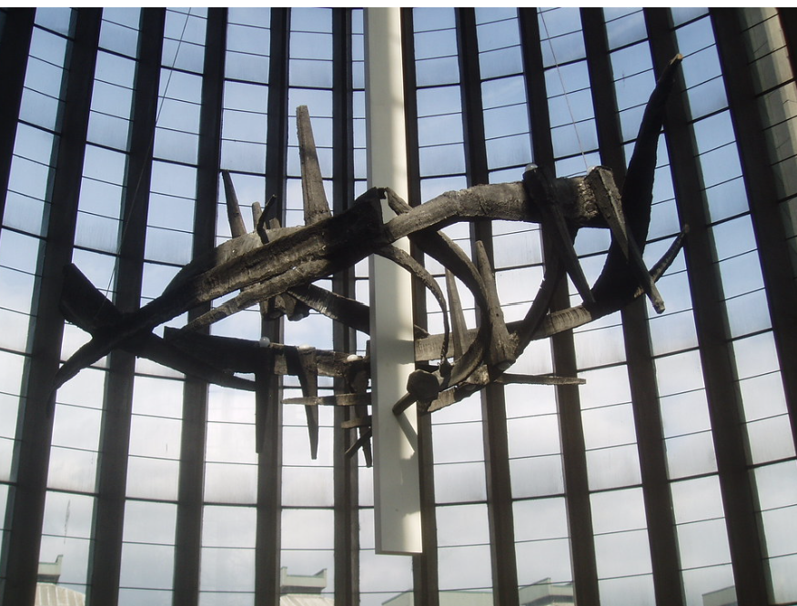
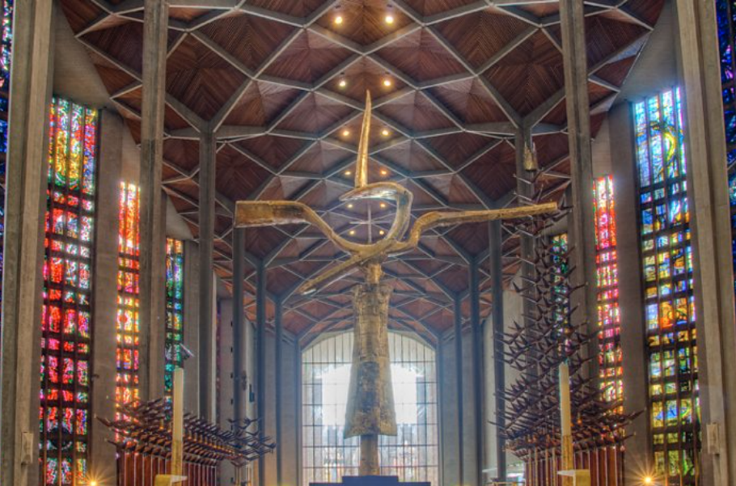
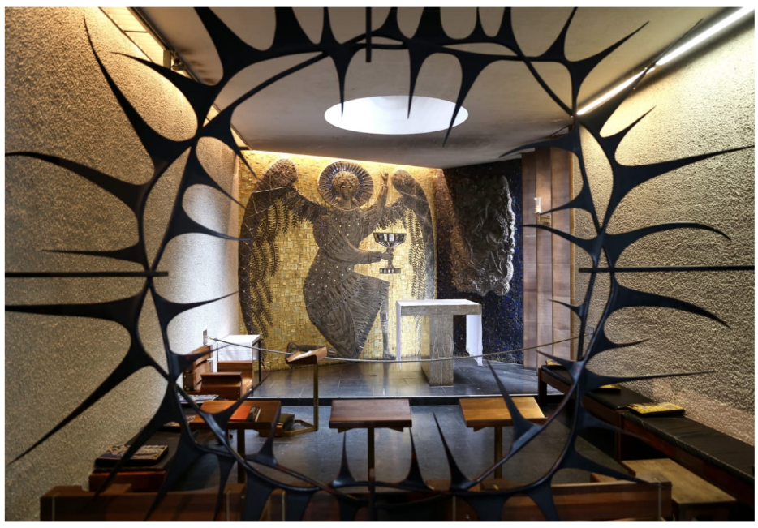
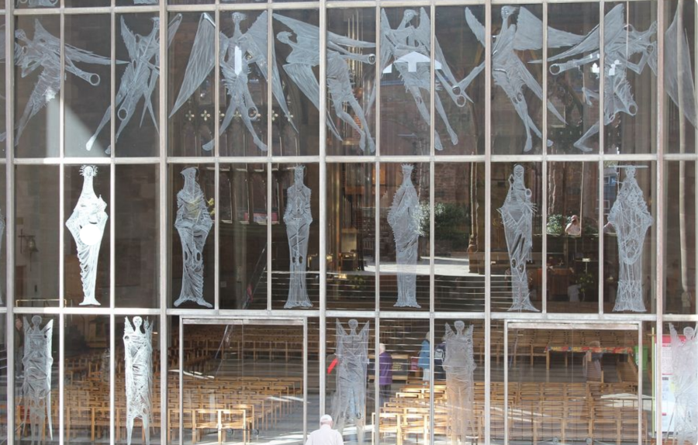
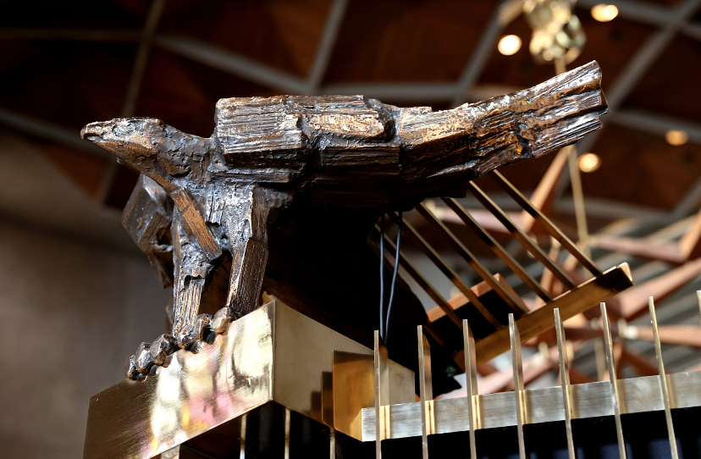
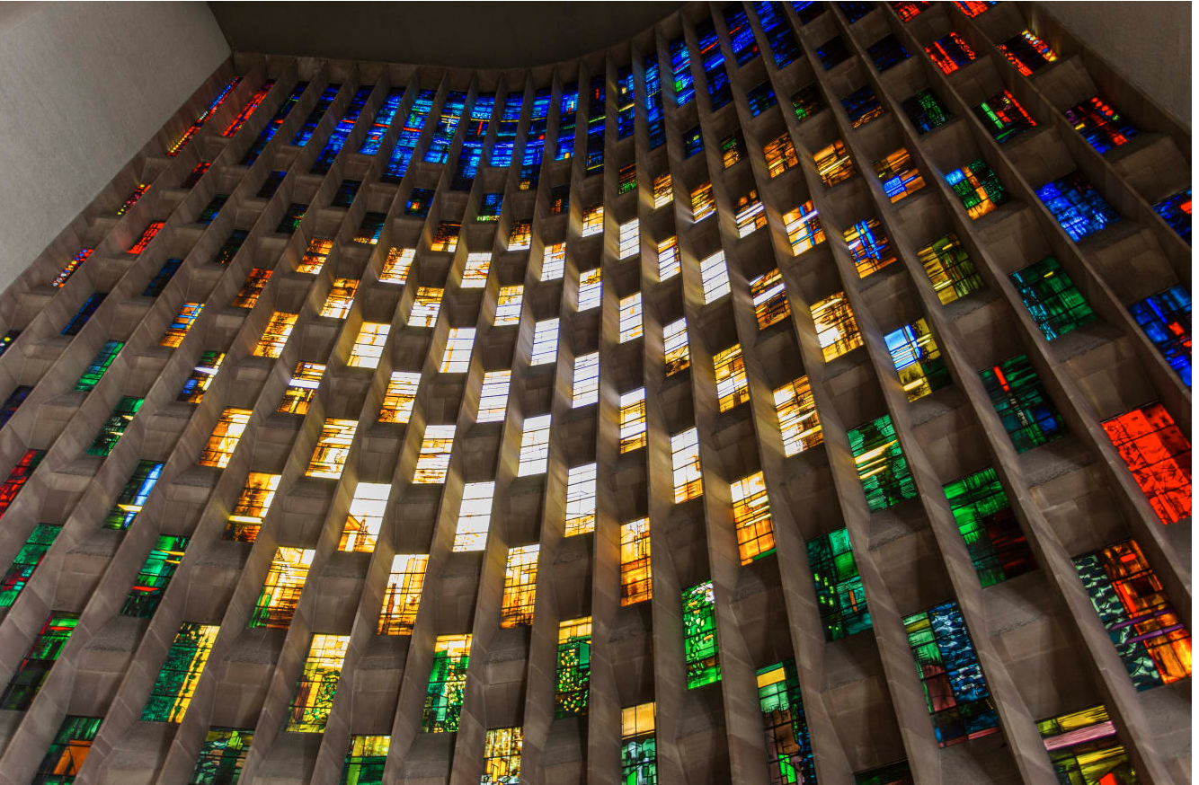
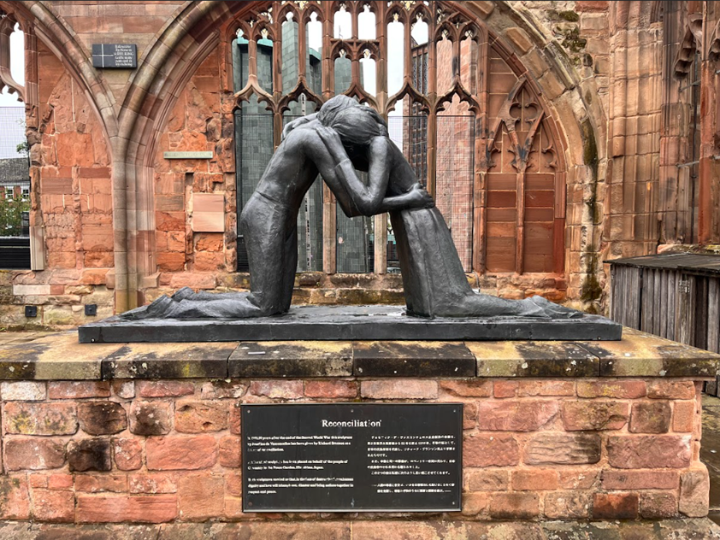
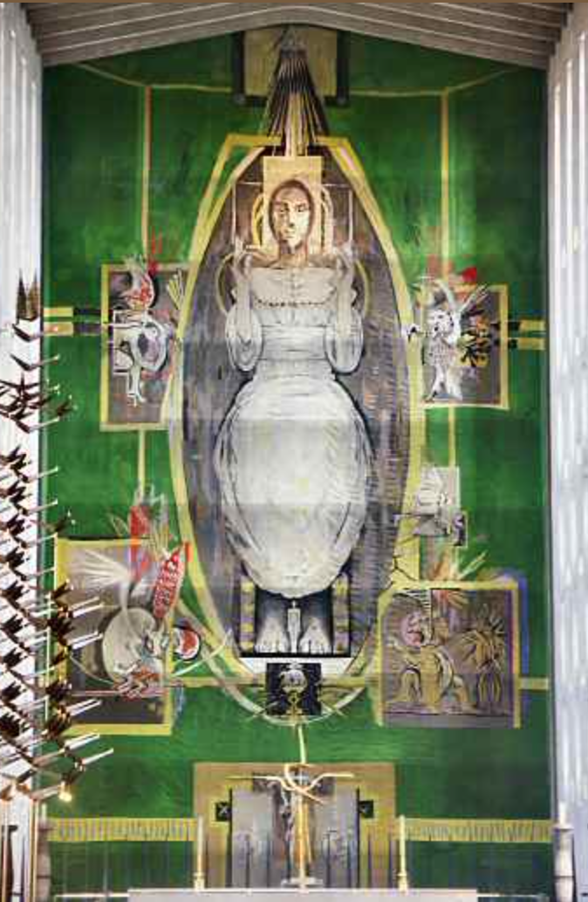
Vocabulary that I will learn and use during this unit of work:
Vocabulary | Definition
Icon | A religious painting usually Jesus Christ or another holy/ religious figure
Architecture | The art and method of building and designing structures with an artistic element
Orthodox | Conforming with established standards, as in religion, behaviour, or attitudes.
Worldview | A person's way of understanding, experiencing and responding to the world, or a philosophy of life.
Allah | Allah is the name Muslims use for their God
Mosque/masjid | A mosque is a place of prayer for Muslims, or followers of the religion of Islam.
Theology | Theology is the study of one or more religions
Cathedral | A cathedral is a Christian church that is the home church of a bishop.
Salvation | A word Christians use to talk about the fact that God saves us from death and let’s Christians live eternally in Heaven.
Sufi | A Sufi is someone who believes in the kind of Islam known as Sufism.
Reconciliation | Reconciliation is the process of bringing people with differences together and helping them understand each other.
Synagogue | It is a place where Jewish people go to pray and study the Torah close Torah
Coventry Cathedral
Artwork

