Slide 1

Worldviews, Conflict, Peace, Forgiveness and Reconcilation
What can religion and worldviews tell us about conflict, peace, forgiveness and reconciliation?
My learning road map:
What I will know and understand
How I will show that I know it
Topic
Lesson 1. What do social
psychologists say about in and out groups?
Lesson 2 What is reconciliation
and what do reconcilers say about it?
What should I already know?
Children should have started to develop an individual’s knowledge and understanding of different religions, beliefs and worldviews which form part of society.
They should be beginning to know about different values and worldviews.
Children should have experience on how to reflect on what they say and how they behave.
1. I know that there are theories about human behaviour and understanding
I Know that these can help people to get along
I am beginning to understand that the notion of belonging is complex and is informed by concepts such as in-groups and out-groups
2. I know reconciliation means ‘restoration of friendly relations’
I know that reconciliation happens after conflict has occurred
National Curriculum:
To continue to develop an individual’s knowledge and understanding of the religions and beliefs which form part of
contemporary society.
To continue to inform on children's values and to encourage them to reflect on what they say and how they behave.
To continue to provoke challenging questions about the ultimate meaning and purpose of life,
Lesson 4 Is reconciliation
Important in Jewish worldviews?
Lesson 3 Why is reconciliation
so important in Christian worldviews?
4. I know that rituals are an important
aspect of many festivals.
I know that some rituals may
include food and artefacts
3. I know that sacred texts contain ideas about God.
I know that these texts are often hard to understand
by those outside of the faith.
I know that these texts may be metaphorical or built on images.
Lesson 5 What is ummah and why
is it important in Muslim worldviews?
Lesson 6 What is ahimsa and why
is it important in worldviews
based on Sanatan Dharma?
5. I know that sacred texts are interpreted by
Individuals.
I know that that important concepts can be drawn from sacred texts.
6. I know that important concepts
can be drawn from sacred text.
I know that individuals may expressing
the same conceptin different ways

Slide 2
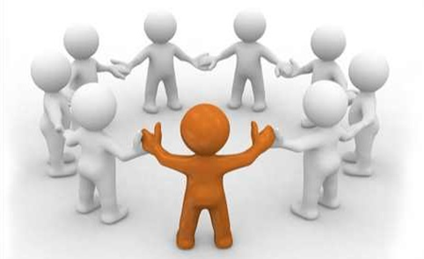
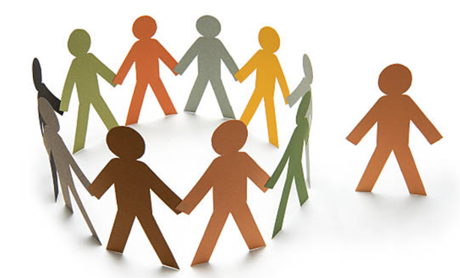
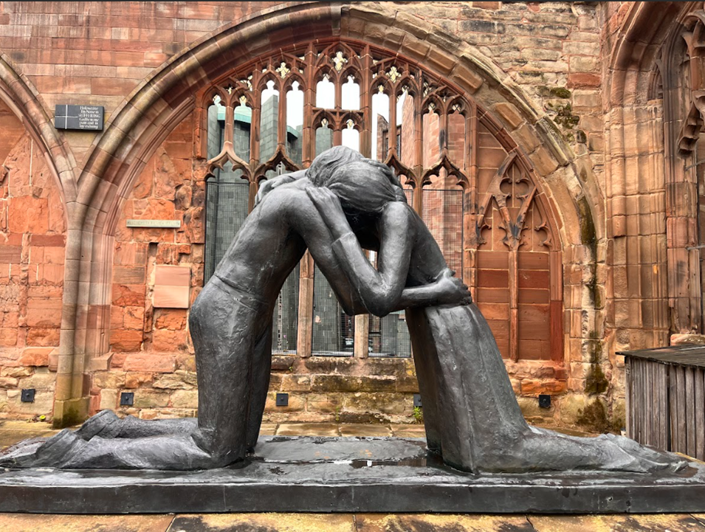
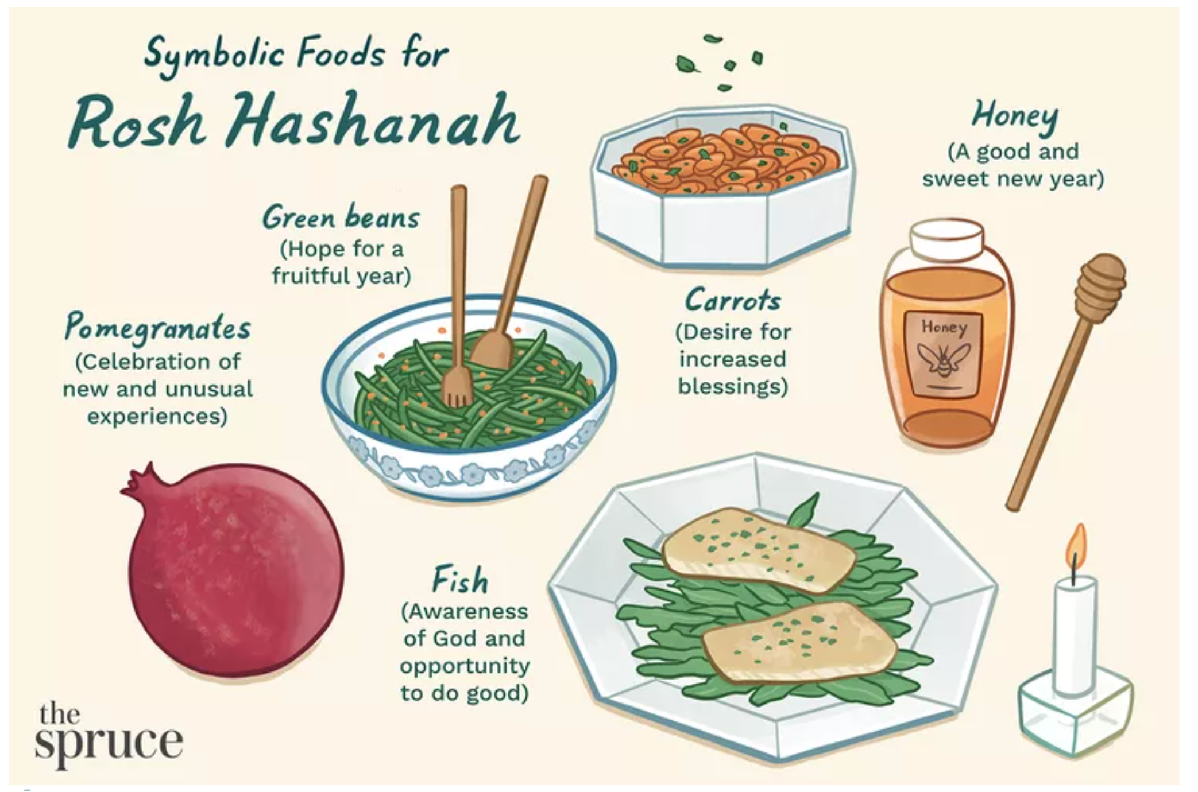
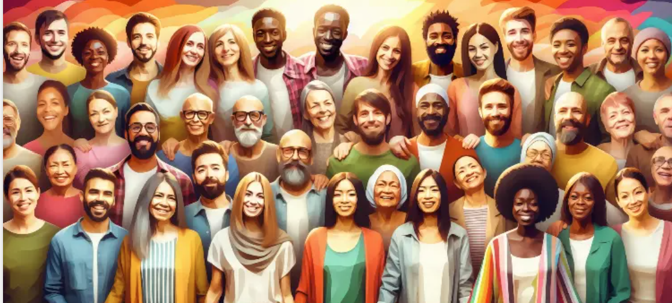
Vocabulary that I will learn and use during this unit of work:
Vocabulary | Definition
Conflict | Is a serious disagreement or argument.
Peace | Means living without being frightened or worried.
Forgiveness | To excuse or pardon someone that has done you wrong.
Reconciliation | The process of bringing people with differences together and helping them understand each other.
Yom Kippur | Yom Kippur is a day where Jewish communities celebrate and ask for forgiveness from God for their sins.
Ahimsa | The principle of non-violence and the belief is that all living things are sacred
Ummah | Ummah a community or the worldwide community of Muslims.
Worldview | A worldview is a person's way of understanding, experiencing and responding to the world, and life.
Non-violence | The avoidance of the use of violence as a matter of principle
Rosh Hashanah | Is the New year celebrated in Judaism. It is the celebration of the creation of the world and marks making a fresh start..
‘in’ group
‘out’ group
reconciliation
Rosh Hashanah symbolic foods
A community or the worldwide community of Muslims (Ummah)

